Slide 1
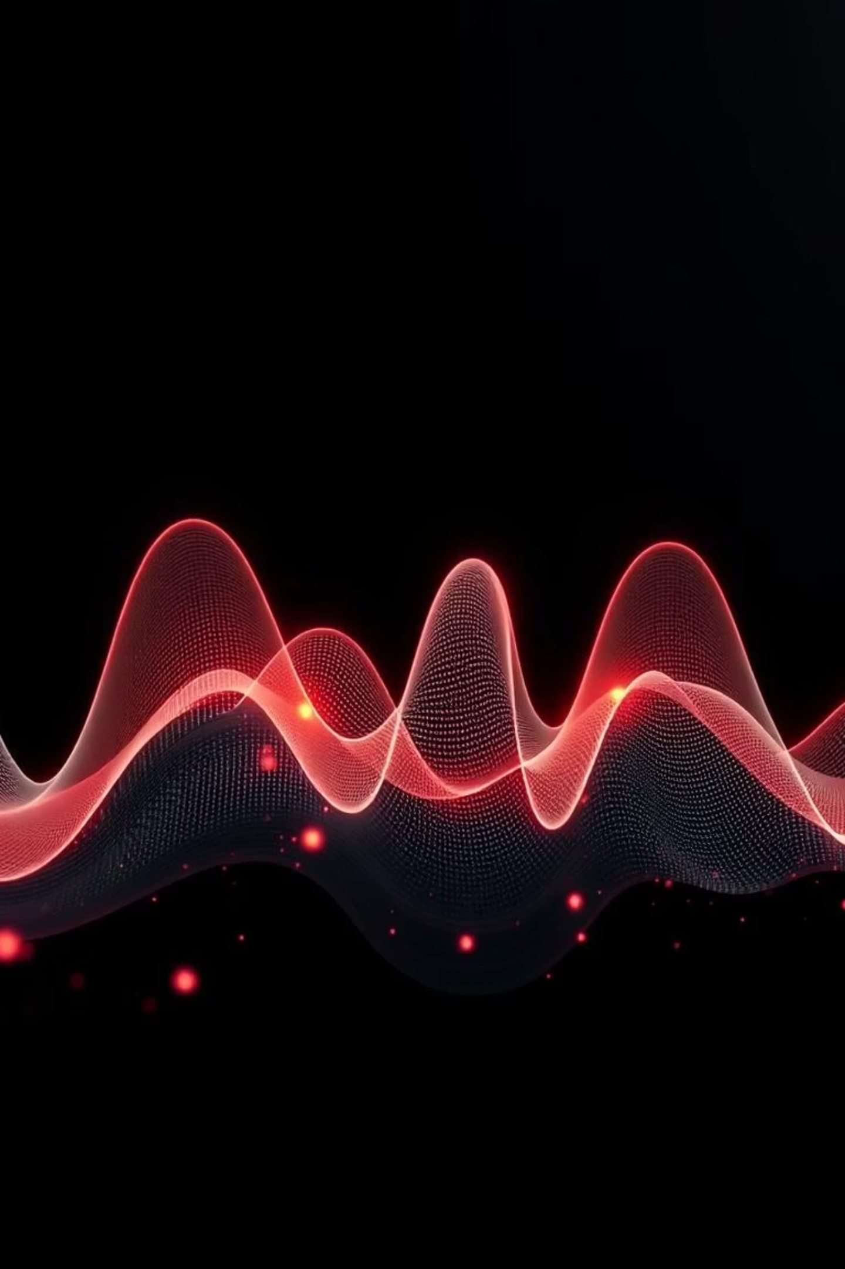
Voice Emotion
Recognition
An Internship Project by Rania Khan

Slide 2

What is Voice Emotion Recognition?
Detecting Human Feelings
Applications
Voice Emotion Recognition (VER) identifies emotions by analysing nuances in speech and audio signals.
VER is crucial in mental health support, enhancing virtual assistants, and improving customer service in call centres.

Slide 3
RAVDESS Dataset
Emotions covered:
1440 .wav audio files
24 professional actors (12 male, 12 female)
Neutral
Calm
Each statement is spoken in two intensities: normal and strong.
Happy
Total of 7356 files including all channels.
Sad
Angry
Fearful
Disgust
Surprised

Slide 4



Feature Extraction with Librosa
Audio Signal Input
Librosa Processing
MFCCs (40 values)
Raw .wav audio files are fed into the system.
The Librosa library processes audio, converting complex wave forms into structured numerical data.
40 Mel-Frequency Cepstral Coefficients (MFCCs) are extracted to capture key vocal features rich in emotional information.

Slide 5
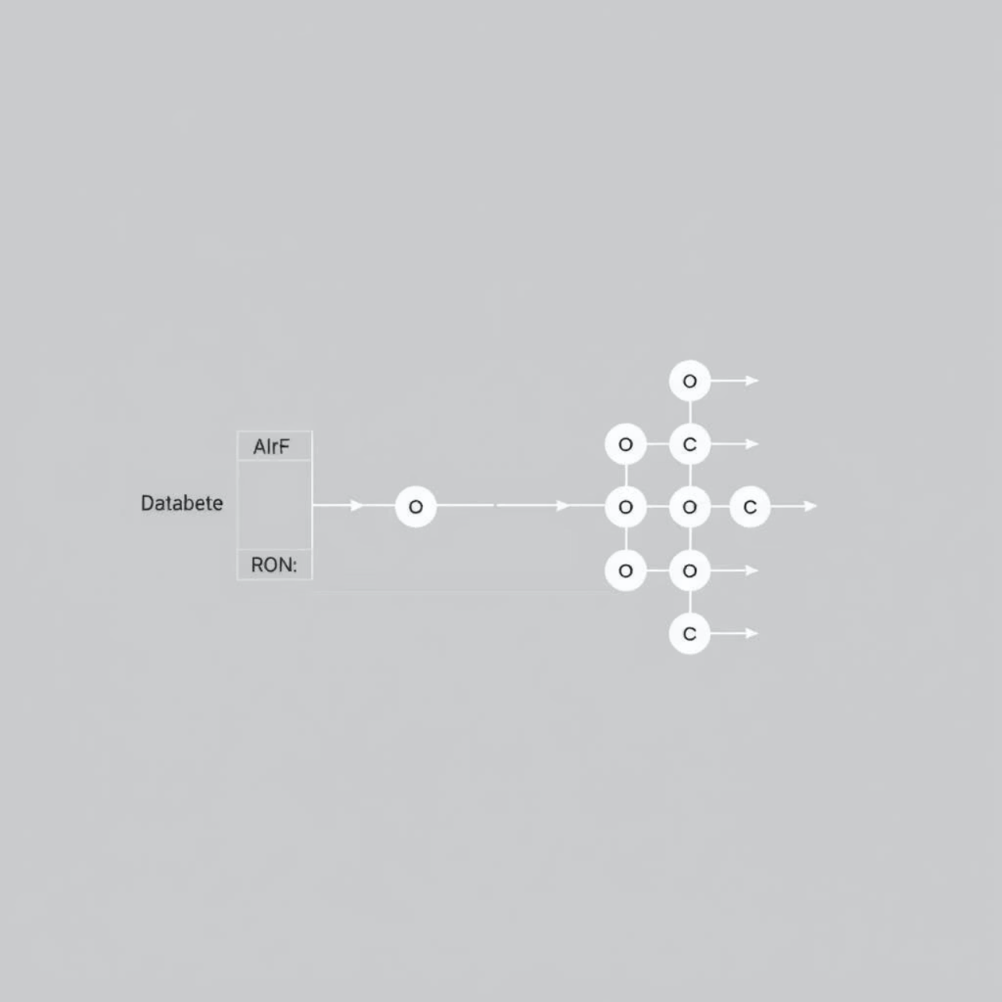
Machine Learning Model
For emotion prediction, a Random Forest Classifier was employed due to its robust performance on diverse datasets.
Process Overview:
Raw audio is transformed into MFCC features.
MFCCs are labelled with corresponding emotions from the RAVDESS dataset.
The model undergoes rigorous training and testing to ensure accuracy and generalisation.
This model effectively predicts emotions from audio inputs, demonstrating the potential of ML in VER.

Slide 6



Gradio Interface
The Gradio interface provides a seamless and interactive user experience for voice emotion prediction.
User Upload
Instant Prediction
User-Friendly
Users can easily upload a .wav audio file for analysis.
The model processes the input and displays the predicted emotion immediately.
Its simple design ensures accessibility for all users.

Slide 7
Conclusion & Future Goals
This project successfully demonstrates the viability of voice emotion detection using machine learning.
Deep Learning Integration
Real-time Input
Cross-Language Improvements
Explore Convolutional Neural Networks (CNNs) and Long Short-Term Memory (LSTM) networks for enhanced accuracy.
Implement live microphone input for dynamic emotion analysis.
Research and develop methods to improve emotion detection across different languages and accents.

